Slide 1
Communication Evaluation
SS.7.C.2.11 Analyze media and political communications (bias, symbolism, propaganda).
Media and Political Communication

Slide 2
Have you ever seen a political ad?
What do you remember about the ad?
Was it about the candidate or the candidate’s opponent?
Would you say it was a positive ad or a negative ad?
Notes:
Discuss examples provided by the students. Have students recall any details about the ad and what it told you about the candidate.

Slide 3
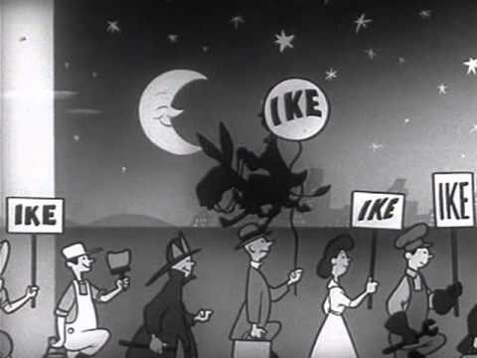
DWIGHT EISENHOWER (1952)

Slide 4
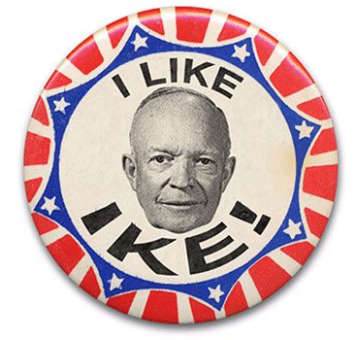
TYPE YOUR ANSWER INTO THE CHAT
1) How does this advertisement makes you feel about the candidate? Why?
2) Would this video make you vote for this person for President? Why?

Slide 5
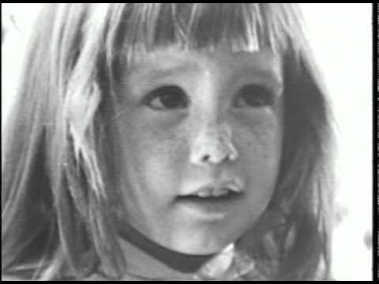
LYNDON JOHNSON (1964)

Slide 6
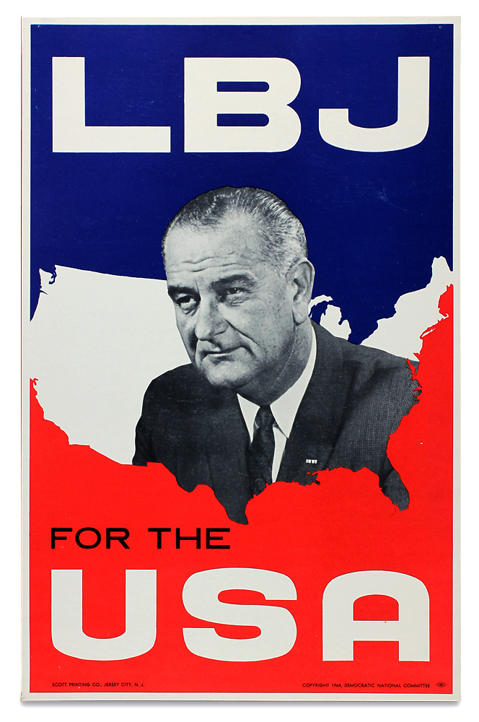
TYPE YOUR ANSWER INTO THE CHAT
3) How is this advertisement different from the first one?
4) Does this advertisement make you feel differently from “I Like Ike?”

Slide 7

Symbolism
The use of symbols to represent ideas.

Slide 8


Bias
A display of favor for or against someone or something.

Slide 9

Propaganda
Statements or ideas that are spread to influence people to think in a certain way.
These are often false or exaggerated.
Notes:
http://www.peta.org/blog/peta-uk-child-abuse-ad-makes-bbcs-top-10-controversial/

Slide 10

Propaganda
Statements or ideas that are spread to influence people to think in a certain way.
These are often false or exaggerated.

Slide 11
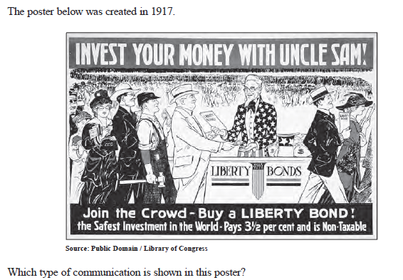

Answer the question below:

